Slide 1

经济学原理：第二讲
蔡洪滨
北京大学光华管理学院

Slide 2
Chapter 2: The Modern Mixed Economy
A. The Market Mechanism
B. Trade, Money, and Capital
C. The Visible Hand of Government

Slide 3
2A: The Market Mechanism
Markets:
  Farmers’ markets
  Online markets
  Stock trading exchanges
  Labor markets
A market is a mechanism through which buyers and sellers interact to determine prices and make transactions.
  Natural order of markets: individual buyers and sellers make their own decisions.
  Markets determine the price of goods (and how many goods change hands between buyers and sellers).
  Market outcomes (prices, trading quantities) are determined in market equilibrium: when supply meets demand.

Slide 4
2A: The Market Mechanism
The function of markets:
  Coordination of production and consumption
  Communication of market information to all market participants: prices serving as a main signal (e.g., pork prices)
Markets solve the three economic problems:
  What: consumers’ money votes----induce profit-seeking firms to produce the goods and services consumers want
  How: competition forces firms to produce goods and services in the most efficient ways (with minimal costs)
  For whom: consumption comes from income, income comes from factors markets: labor income, land income (rent) and capital income (interests and capital gain).

Slide 5
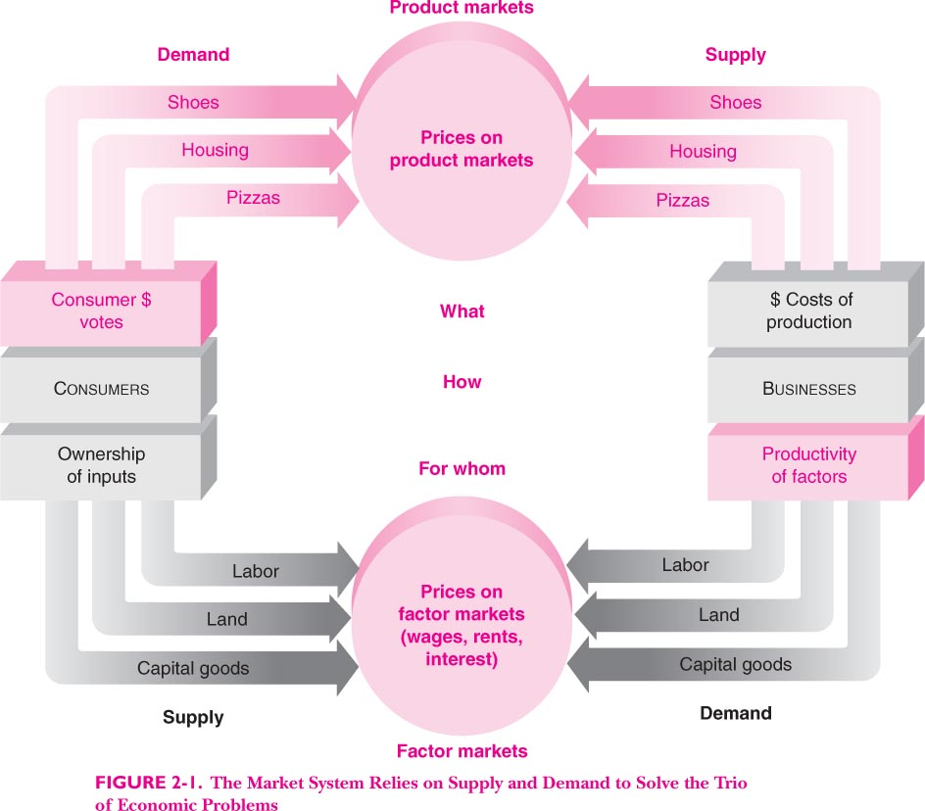

Slide 6
2A: The Market Mechanism
The “dual monarchy”
  Taste (preferences): what people want. Given how much income people have, taste (preferences) and income determine demand.
  Technology: how inputs can be transformed into outputs. Combined with how much resources (inputs) the society has, technology and resources determine supply (the PPF).
The market mechanism matches tastes and technology.
An efficient allocation is a point on the PPF (i.e., productive efficiency) that best satisfies the society’s taste.
When can the market mechanism achieve such an efficient allocation?

Slide 7
2A: The Invisible Hand
Adam Smith: the market is an invisible hand
  The birth of modern economics: “The Wealth of Nations”, 1776 (the other book of his: “The theory of Moral Sentiment).
  Modern version of the invisible hand: under certain conditions, a perfectly competitive market economy can achieve efficient outcomes, using prices as coordination and communication devices that guide numerous individuals and firms who make their own production and consumption decisions.
  Thus, this invisible hand of the market leads self-interested individuals to achieve socially optimal purposes.
  “By pursuing his own interest he frequently promotes that of society more effectually than when he really intends to promote it.”

Slide 8
2B: Trade, Money and Capital
An advanced market economy involves intensive trade, specialization, and division of labor.
Trade: domestic or international
Specialization: concentrate on a particular set of tasks.
  Specialization of labor (division of labor): each individual perform a small set of tasks in the whole production process. This allows people to gain specific skills and be much more productive. This will be much more efficient than doing too many things.
  Specialization of land: agricultural, industrial, commercial, residential, forest, recreational, …
  Specialization of capital:

Slide 9
2B: Trade, Money and Capital
Gains from trade:
  Compared with self-sufficiency, with specialization people and countries need to engage in voluntary exchange, which are mutually beneficial and socially more efficient.
The importance of a unified national market: local trade barriers, U.S. federal law, China’s case
Globalization: an increase in economic integration among nations.
  Reasons: decline in transportation and communication costs, and tariffs and other trade barriers.
  International trade volume has been increasing rapidly.
  Specialization of labor across countries: e.g., cars, computers, Apple Iphone
  Specialization of capital and integration of financial markets
  Who benefits from globalization: China’s case

Slide 10
2B: Trade, Money and Capital
Capital: industrialization is accompanied by capital accumulation
  Traditional agricultural production uses little capital.
  Industrialization: capital (machinery, transportation, production plants,…) becomes more and more important as technology advances.
  Capital itself needs to be produced from raw materials and intermediary inputs: machinery.
  Human capital: education and skill acquisition.
Capital accumulation needs investments, which comes from saving, or sacrifice of current consumption.

Slide 11
2B: Trade, Money and Capital
In order to encourage people to make investment to build capital, property rights must be well protected.
Property rights: rights of owners to use, dispose, profits from their properties.
Property rights are limited: the use of cars in Beijing, the change of your houses, the amount a factory can pollute, …
When property rights are ill-defined, people have little incentive to protect them and make investments in building capital.
  State-owned enterprises
  Collectively owned: forest land
  Pollution and environment protection

Slide 12
2C: The visible hand of government
In any modern society, government plays important roles.
Government provides a legal environment:
  Define and protect property rights.
  Enforce contracts to facilitate trade.
  Regulations.
And government does much more……The visible hand.
Why is government needed in economic affairs?

Slide 13
2C: The visible hand of government
Efficiency reasons: the market mechanism is not perfect (market failures), so the visible hand of government can potentially help improve efficiency.
  Imperfect competition (monopoly, natural monopoly, oligopoly, collusion,…): government solutions include anti-trust laws, regulations of prices and quantities, public firms.
  Externalities: impose costs (negative externalities) or benefits (positive externalities) on others without proper compensation, such as pollution, traffic jam, noises, gardens, knowledge spillover.
  With negative externalities, people tend to do more than the efficient level (because they do not bear the costs), so governments should regulate to limit the overdo.
  With positive externalities, people tend to do less than the efficient level (because they do not get the benefits), so governments should subsidize, e.g. education, public health.
  Public goods (e.g., national defense, infrastructure, clean environments): extreme case of positive externalities with non-exclusivity and nonrivalry. Governments often decide how much to provide.

Slide 14
2C: The visible hand of government
Equity reasons: market economy may lead to quite unequal income and wealth distribution (though efficient) that is unacceptable to the society.
Income distribution depends on many factors: efforts, education, abilities, inheritance, factor prices, luck.
What is a fair income distribution? In China’s case, ….
Government’s roles:
  Tax the rich: progressive tax.
  Help the poor: transfers payments, subsidies, …
  Government programs: social security, social safety nets (unemployment, medical payments, ….)
How much should government do in pursuing equity?
  Incentives to work
  Protecting basic human rights
  Social justice
Aside from moral judgment, one still needs economics to analyze what is the most effective way to achieve the equity goals.

Slide 15
2C: The visible hand of government
Governments also use macroeconomic policies to achieve economic growth and stability.
The founding father of modern macroeconomics: Keynes.
Government macroeconomic policies:
  Fiscal policies: taxing and public spending (e.g., stimulus plan)
  Monetary policies: interest rates, credit conditions.
  Exchange rate policies

Slide 16
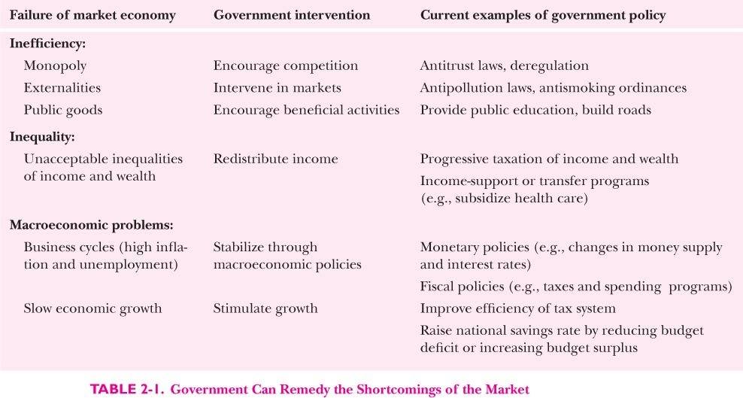

Slide 17
2C: The visible hand of government
China’s experience after 1949:
  1949-1978: the central planning experiment, try to minimize the role of market
    Central planning determines inputs and output plans
    State-owned enterprises (SOEs)
    Collective production in rural areas
  1978-: economic reforms that gradually increases the role of the market mechanism
    Relax and eliminate price controls
    Reform SOEs
    Agricultural reforms
    Opening up, joining the WTO
  Current state of the economy: a mixed economy still with too heavy government interventions (further reforms are badly needed), many uncoordinated and un-constrained hands of government
  “市场在资源配置中起决定性作用，政府起积极作用。”

Slide 18
Reminder:
  Review
  Preview
  Homework 1 (due date: 9-21)
  Thank you!

